Slide 1
SODA - One Data Framework, Infinite Possibilities
Rakesh Jain, IBM Research
Anjaneya Chagam, Intel Corporation

Slide 2
SODA Foundation Overview A NEW HOME FOR DATA AND STORAGE COLLABORATION
SODA Foundation All Rights Reserved.

Slide 3
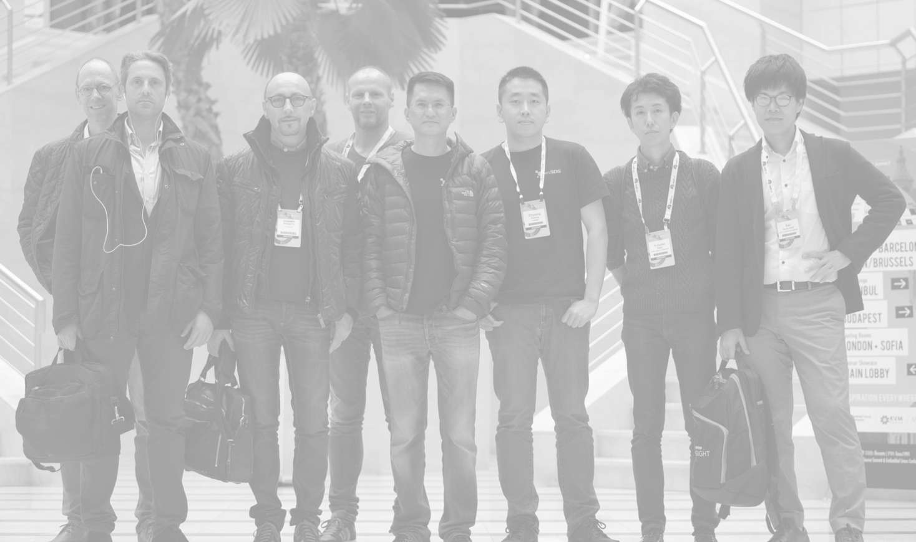
A LITTLE BIT OF HISTORY
SODA Foundation is a transformation of the Linux Foundation OpenSDS technical project. OpenSDS was initiated at the end of 2016 by Dell EMC, Fujitsu, Hitachi, Huawei, Intel, and Vodafone to address the challenges of storage integration in the cloud era.
As OpenSDS grew, there were increasing requests for it to expand its scope to support cloud native, edge, IoT, big data, machine learning, AIOps, DataOps, and more.
With the majority support of OpenSDS members, we are transforming the project into SODA Foundation. SODA Foundation is the home for open source data and storage projects.
FIRST OPENSDS EVENT @OPEN SOURCE SUMMIT 2017, PRAGUE
SODA Foundation All Rights Reserved.

Slide 4

















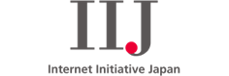




SODA FOUNDATION
PREMIER MEMBERS
SODA Foundation is an open source project that aims to foster an ecosystem of open source data and storage software for data autonomy. SODA Foundation is organized as a Directed Fund Project under the Linux Foundation with funding from Premier Members and General Members.
The Foundation provides an open, collaborative, and neutral home for project stakeholders to coordinate their development and community investments in the SODA ecosystem.
GENERAL MEMBERS
SUPPORTERS

Slide 5

MISSION
To foster an ecosystem of open source data management and storage software for data autonomy
To offer a neutral forum for cross-projects collaboration and integration
To provide end users quality end-to-end solutions
SODA Foundation All Rights Reserved.

Slide 6


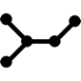


















NOW
FRAGMENTATION
IOT
AI/ML
BIG DATA
CLOUD NATIVE
EDGE
CLOUD
There is no single vendor solution that can undertake the humongous task of handling all kinds of data operations from the point of data creation, to data storage, to data archive and data disposal. Challenges include virtualization, cloud native, IoT, big data, AI and machine learning, with the added complexity of data residing everywhere beyond the data center in any cloud or at the edges.
The result is that multiple vendor solutions have to be put together causing these problems:
data silos
non-standard interfaces
spot solutions
excessive data transfers
mostly manual operations
limited scalability
DATA MANAGEMENT
…
Lineage
Copy Mgt
Backups
Replication
Transformation
…
Tiering
Security
Snapshots
Access
Retention
Migration
Archive
…
EDGE STORAGE
ON-PREMISE STORAGE
CLOUD STORAGE
#ossummit #lfelc

Slide 7

SODA
ONE DATA FRAMEWORK
IOT
AI/ML
BIG DATA
CLOUD NATIVE
EDGE
CLOUD
SODA is a single data framework connecting disparate solutions into seamless end to end solutions. This framework is open source, allowing any developer, vendor, or end user to build and extend upon it.
The value propositions of this framework are:
data mobility
standardized interfaces
interoperable solutions
optimized transfers
autonomous operations
high scalability
DATA MANAGEMENT
…
Lineage
soda
Copy Mgt
soda
Backups
Replication
soda
soda
Transformation
…
soda
Tiering
Security
soda
soda
Snapshots
soda
Access
soda
Retention
Migration
Archive
…
soda
EDGE STORAGE
ON-PREMISE STORAGE
CLOUD STORAGE

Slide 8
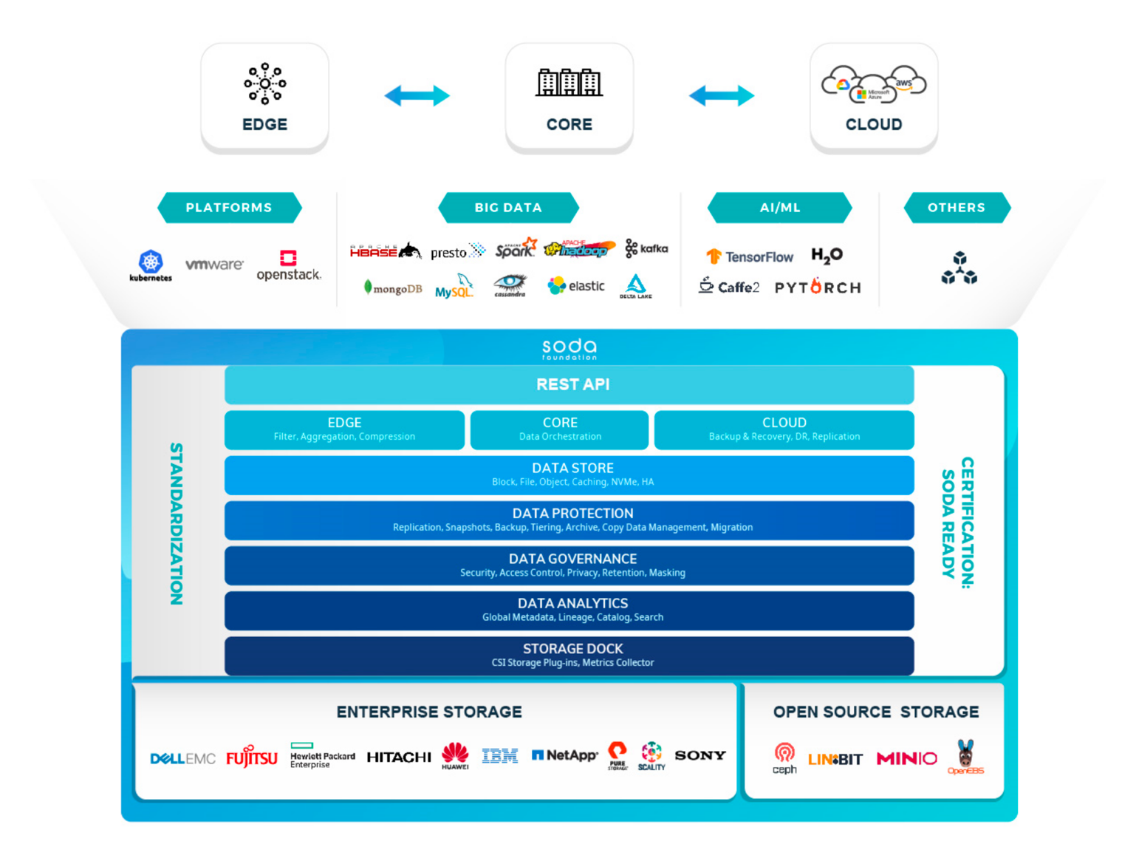
THE SODA FRAMEWORK
SODA is an open source unified autonomous framework for data mobility from edge to core to cloud.
HIGHLIGHTS
open source - data and storage projects
standardization – data and storage management
ecosystem – hardware, software, solutions, services
certification – ecosystem components, developers, operators
SODA Foundation All Rights Reserved.

Slide 9
SODA PROGRAMS (planning)
PROJECTS
SODA INCUBATOR: Program to help projects grow
EVENTS
SODA Forums
Conference Talks
Sponsorships
Meetups
Webinars
DEVELOPERS
SODA BOOTCAMP: Program to help developers experience, learn and contribute to projects
VENDORS
SODA FOUNDRY: Program to help vendors build and showcase SODA-based solutions in SODA Marketplace
SODA
USERS
SODA LAB: Program to help users learn, test and use SODA by developing a POC solution based on user needs
COMMUNITY
SODA AMBASSADOR: Program to empower members with resources and tools, with incentives to promote SODA
SODA Foundation All Rights Reserved.

Slide 10
Governance

Slide 11
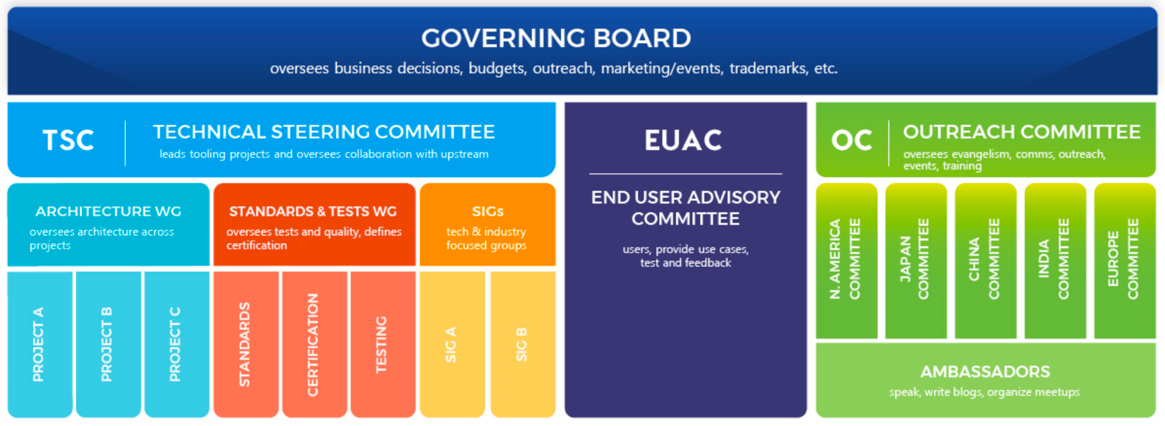
GOVERNANCE
SODA Foundation is overseen by the Governing Board and supported by the Technical Steering Committee (TSC), End User Advisory Committee (EUAC) and Outreach Committee (OC).
SODA Foundation All Rights Reserved.

Slide 12
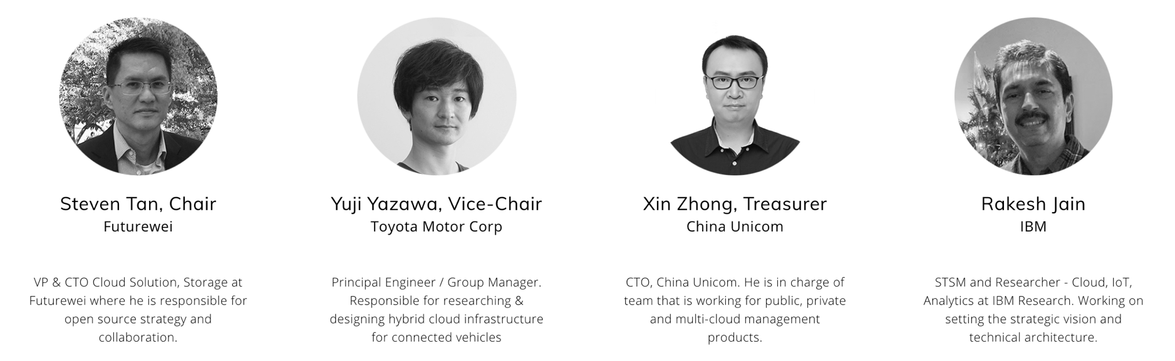
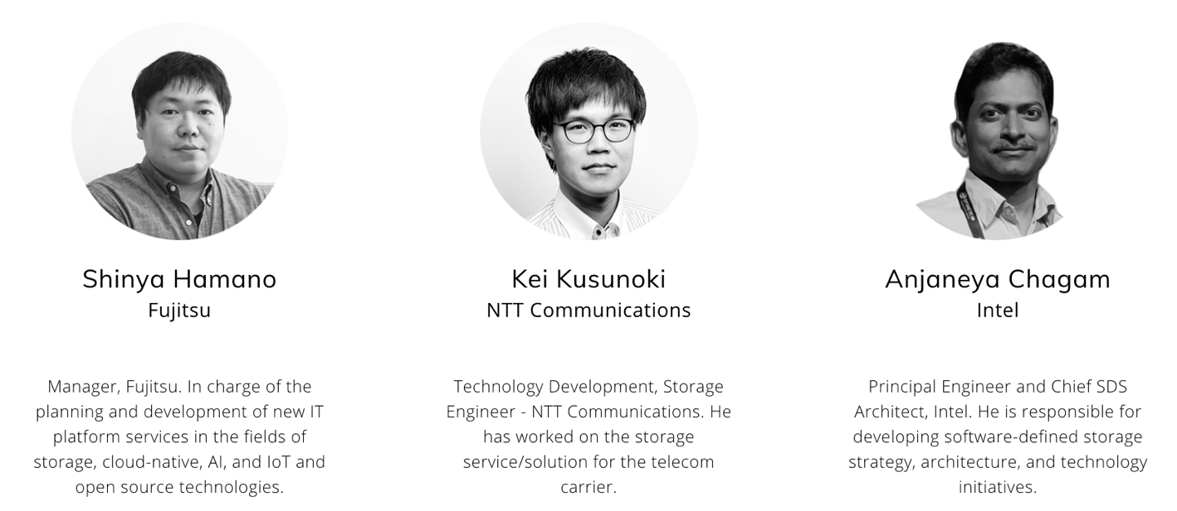
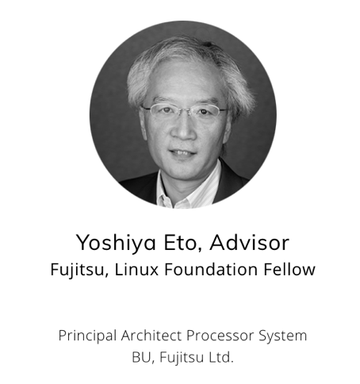
GOVERNING BOARD
SODA Foundation All Rights Reserved.

Slide 13
SODA Projects

Slide 14
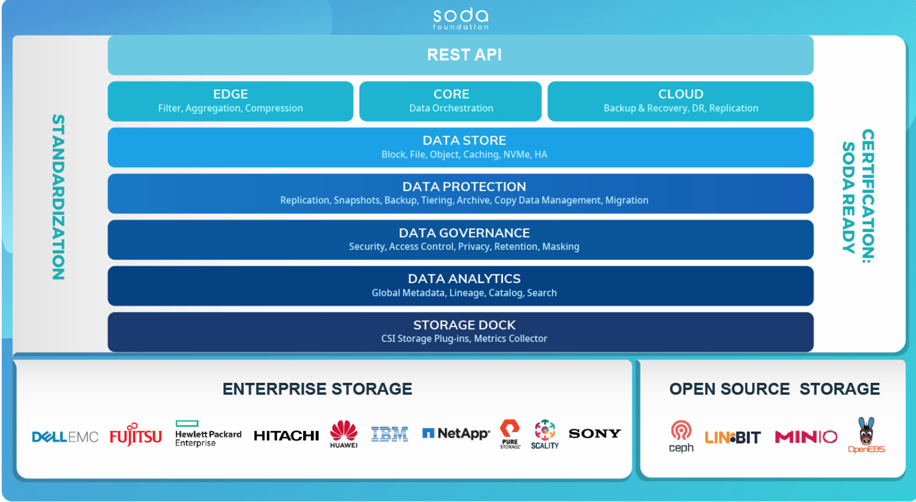
SODA ARCHITECTURE
SODA Foundation All Rights Reserved.

Slide 15
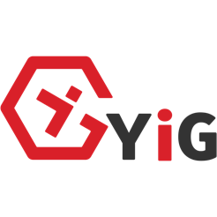
SODA PROJECTS
SODA Projects make up SODA as an open source offering
CORE PROJECTS
Core Projects are initiated by the SODA community. They form the core SODA framework and follow the SODA release roadmap. Core Projects are governed by the TSC.
API
CONTROLLER
MULTICLOUD
TELEMETRY
DOCK
DASHBOARD
NATIVE/Member PROJECTS
Native Projects are projects donated to SODA Foundation and are either initiated by SODA members or 3rd-party organizations. Native Projects are supported by the SODA Foundation but are governed independently. They either follow the SODA release roadmap or have their own release roadmap.
Member Projects
(incubated)
Member Projects
(to be incubated)
SODA Foundation All Rights Reserved.

Slide 16
SODA Use Cases

Slide 17
Use Case: Cloud Native Storage
Vodafone, KPN, Yahoo Japan,
China Construction Bank Fintech
BACKGROUND
Implementing a cloud native strategy
CSI
SODA
Unified Orchestration, Telemetry, Intelligence, Multi-Cloud
ISSUES
Unified Ecosystem
Using storage solutions from multiple vendors
Data Storage Solution A
Data Storage Solution B
Data Storage Solution C
Public Cloud
REQUIREMENTS
Must be a open, extensible
Must support public clouds
A Storage
B Storage
C Storage
SOLUTION
Heterogeneous Backup, Replication, Migration, Tiering, Archiving, …
Profile-based storage provisioning for Kubernetes
Flexible storage resource allocation
SODA Foundation All Rights Reserved.

Slide 18

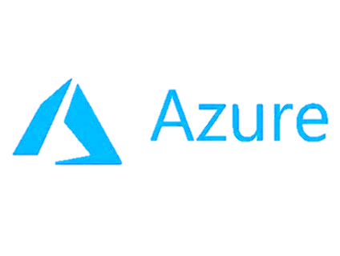

SODA Kubernetes Use Case
BENEFITS
One plugin for each framework
Add new storage with same plugin
100+ block and file storage supported
Data ops across storage systems
Common data protection, security, etc.
Monitoring and analytics is aggregated
Extend across data centers and clouds
Common platform for K8S and others
Automate workflows
SODA Dashboard
Kubernetes Master
OpenStack
VMware
Others
Intelligence
Automation & Orchestration
OpenStack
Plugin
VMware
Plugin
Other
Plugin
Node
Telemetry
Pod
SODA CSI
Plugin
SODA
SODA Multicloud
API
Multi-Cloud
Data Controller
Cloud Dock
Vol
Controller
AWS
Vol
Azure
Storage Dock (storage mgt drivers)
Google
Node
IBM
Pod
SODA CSI
Plugin
Cinder
Manila
Swordfish
Ceph
Ceph S3
Vol
70+
Enterprise Storage
Supported
50+ File Systems Supported
Swordfish Storage
Ceph RBD
Vol
S3 Gateway
Data replication, migration, …
Cloud snapshot, migration, tiering, …
SODA Foundation All Rights Reserved.

Slide 19
Use Case: Data Lifecycle
Toyota
BACKGROUND
Car data sent to edge for edge computing, data move to primary storage for big data, to secondary storage for ML, and to archive storage
ISSUES
EDGE
soda
Need a platform for lifecycle management from edge to DC, to cloud
Storage
Archive Storage
DATA CENTER
REQUIREMENTS
Primary Storage
soda
Data lifecycle based on age
Supports edge to cloud with customizable storage tiers
Secondary Storage
Archive Storage
SOLUTION
Policy-based data lifecycle with age
Tiering across edge, data center and cloud
SODA Foundation All Rights Reserved.

Slide 20

Use Case: Data Lake
China Unicom
KEY
A SODA Data Store project
A collaboration between SODA Multicloud + China Unicom YIG project
Global metadata single namespace
Scalable on-premise storage using Ceph clusters
Hybrid/multi-cloud storage
Common S3 interface for data streaming, analytics, ML
S3 Select in development
Search Engine planned
Status: In development, release Q2/Q3 2020
Data Streams
Data Analytics
Machine Learning
soda
Global Metadata
Search Engine
Scalable On-Premise Storage
Multi-Cloud
Ceph
Cluster
…
Ceph Cluster
PUBLIC CLOUD
SODA Foundation All Rights Reserved.

Slide 21
Use Case: Multi Cloud
AWS
NTT Communications
Storage
BACKGROUND
Uses vendor specific solution for cloud snapshots and restore
DATA CENTER
ROBO
Storage
ISSUES
Storage
Snapshot and restore on single vendor storage
Supports AWS only
Azure
REQUIREMENTS
Storage
Google
AWS
soda
Storage
Multi-vendor storage snapshot and restore
Snapshot and restore to/from multiple clouds
Storage
soda
soda
SOLUTION
DATA CENTER
Snapshot/restore with any storage
Policy-based multicloud data control
ROBO
soda
soda
Storage
Storage

Slide 22
Year 2020 Plan
Adoption
China Unicom
China Construction Bank
Toyota
Yahoo Japan
NTT Communications
Vodafone
Collaboration
CNCF – K8S, Prometheus, Fluentd, OpenEBS, KubeEdge, Rook, CFS
Platforms – Vmware, Redhat, SUSE
Clouds & Storage – AWS, Azure, Google, IBM, Huawei
Open Source Projects – Ceph, Minio, Spark, Hadoop
Partners Solutions - Intel, IBM, Sony, Linbit, Mayadata, StorageOS, Scality, ProphetStor, eHualu, Scutech, Wipro, Click2Cloud
soda
Development
Projects: SODA Core, Data Store, Edge, Cloud, Analytics
Standardization: SNIA, SPC, CESI - Data Protection, Data Governance, Data Lifecycle
Certification: SODA Ready
Awareness
SODA Forums – Amsterdam, Shanghai, Tokyo, Bengaluru, Boston
SODA Meetups – China, Europe, India, Japan
SODA Sponsorships – KubeCon, OSS, Cephalacon, SNIA SDC, CloudNativeDays Japan
SODA Foundation All Rights Reserved.

Slide 23
SODA Demo

Slide 24
Cloud Vendor agnostic Multicloud Data Management
Demo: (Object)
Easy addition of Cloud Vendor Backend
Basic Object Creation
Seamless Data Mobility Across cloud vendors (migration, simple copy/paste)
SODA Foundation All Rights Reserved.

Slide 25
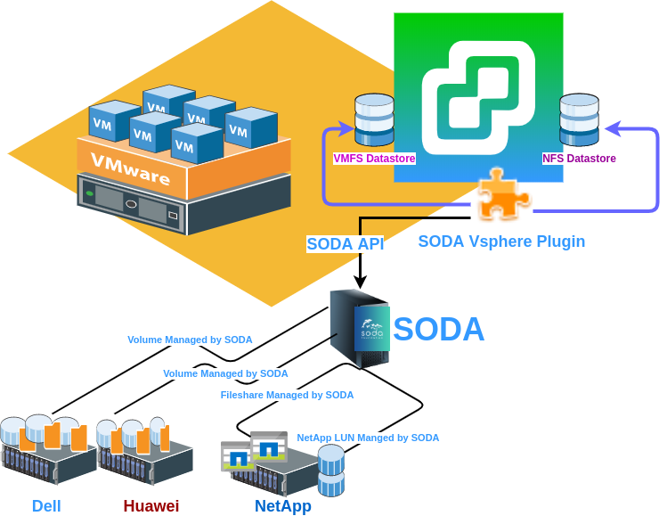
SODA Northbound VMWare Plugin
One platform to provide storage to VMWare Datastore from different backends
SODA Foundation All Rights Reserved.

Slide 26

MISSION
to foster an ecosystem of open source data management and storage software for data autonomy
to offer a neutral forum for cross-projects collaboration and integration
to provide end users quality end-to-end solutions
SODA Foundation All Rights Reserved.

Slide 27
Thank you
SODA Foundation All Rights Reserved.

Slide 28
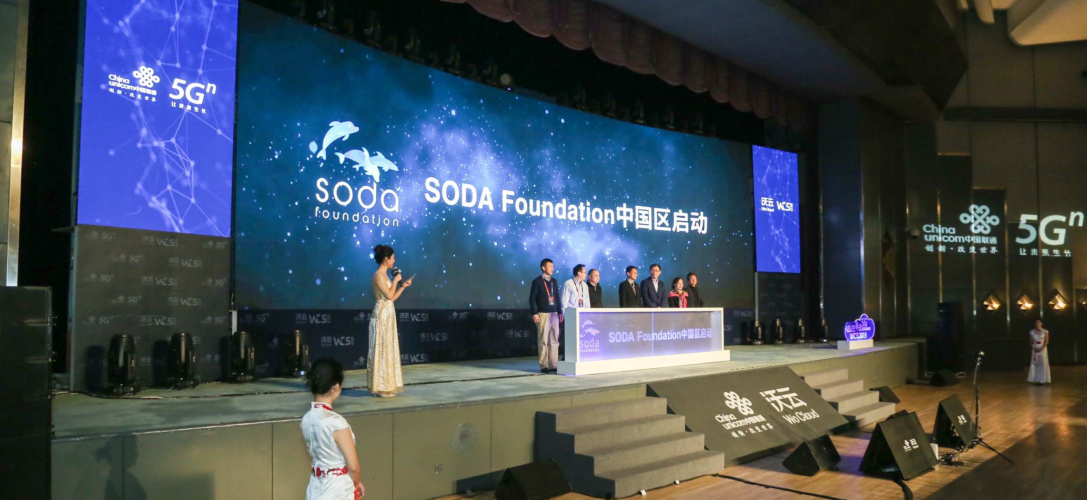
SODA CHINA COMMUNITY LAUNCH Dec 20, 2019
SODA Foundation All Rights Reserved.

Slide 29
Please take a moment to rate this session. Your feedback matters to us.

